Slide 1
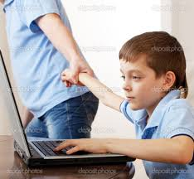
Parenting through a technological age
Colman Noctor
2017

Slide 2
How to be a parent in 2017
Make sure your child’s
Academic, social, psychological, spiritual, physical and nutritional needs are met,
While being careful not to over-stimulate, under-stimulate, helicopter or neglect them,
In a screen-free, processed food free, negative-energy free, body positive, socially conscious, egalitarian yet authoritative environment that
Nurtures but fosters independence, is gentle but not over-permissive
In a two-storey home, preferably in a cul de sac, with a back garden with 1.5 siblings, spaced evenly apart…..
Not forgetting the coconut oil….

Slide 3
Being a parent in literally every generation prior to now
Keep them safe and feed them sometimes

Slide 4
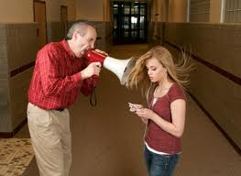
The powerlessness of parenting
Accept that you cannot live your child’s life for them
Accepting that the control over their lives is becoming less as they individuate
Try to instil a sense of internal decision making that will help them to make good decisions when you are not around.

Slide 5

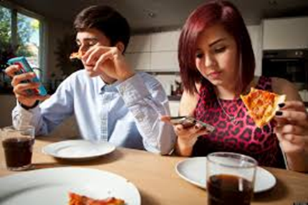
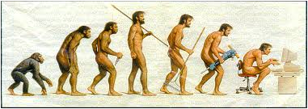
This task has been made much more challenging with the advent of technology

Slide 6
Is the internet the greatest social experiment of our time?
The landscape has changed in terms of:
Family life
Communication
Relationships
Work lives
Our relationships with ourselves

Slide 7
Not an alarmist approach
I love technology
I recognise its benefit to convenience
There are many pluses to the tech evolution
I just wonder because we have invited it so openly into our lives and our families, have we asked enough questions? Or the right questions?

Slide 8

Why is this important to me?
My introduction to the technological seduction
My 1st status update
New presentations and insights
Clinical is the thin end of the wedge
Regulation a core task of adolescence but not a feature of the online world

Slide 9
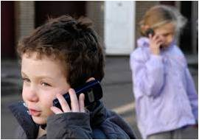
Myths of Digital Immigrants and Digital Natives
Not so much an issue anymore
The change in conversation in recent years
Different methods of communicating and relating
All they have ever known..
The trick behind the magic
A question of what is being missed, in terms of skills..

Slide 10
But its too neat to just blame the kids
We are in on this too

Slide 11
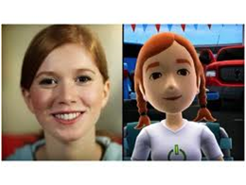
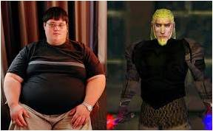
BYpass The messiness of relationships
Can we edit, cut and paste the self?
What is the cost of that?
Co-presence
Changes in how we relate
Is there an impact into our relationship with ourselves?

Slide 12
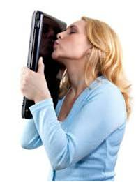
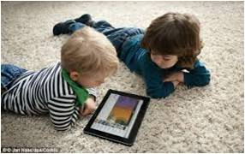
The humanisation of technology
Human – Machine interface
Sat Nav
Talking Teddies & Talking Apps
Self Reading Books
As technology has become more human have we become less human.
Disposability of technology, dysregualtion of time, electronic paper trails,

Slide 13
There is no app for your lap

Slide 14
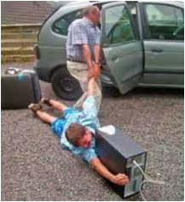
The 'On Demand' Culture
1st World problems
Sold an idea of ‘On Demand’ happiness
No expectation of delaying gratification
Speed and convenience sells
No 'Learning to wait'

Slide 15

Increase in expectation equals an increase in demand and perhaps an increase in unhappiness

Slide 16

iPhone Envy
Technology and attachment
The allure of the smart phone
The newness of the relationship
Competition with the device
iPhone babies are not 8 yet!!!

Slide 17
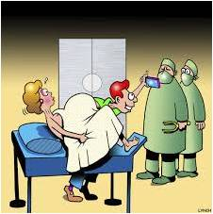
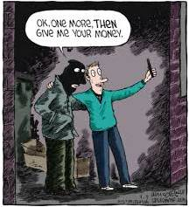
What is the APPEAL?
Recognition (selfie)
Validation (likes)
Feeling (response)
Capture more than experience
Meaning (It would be better if it moved)

Slide 18
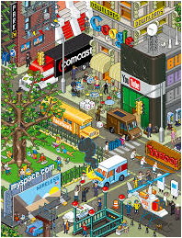
The Internet like a city....
Prohibition not the answer
Rapunzel Parenting
Regulation is the issue
Need to develop internal regulation which is a lot to ask

Slide 19
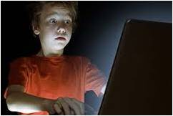
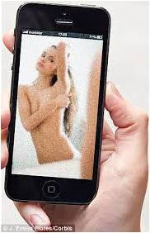
Regulation an issue of adolescence
FOMO
Sexualisation
Cyber-bullying
Viral scandals

Slide 20
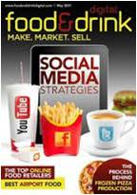
Social snacking
The junk food of communication
Needs to be moderated
We manage treats for children and regulate their desire
Why not the same with technology
Learn from the innovators

Slide 21
The unspoken tech challenge
If we get past the distraction of technology and its potential to impact on obesity, social communication and predatory risks, there are far more pervasive risks to identity and selfhood.
The arms race for attention
The non-ethics of the town planning
Providing an unlimited menu of what we desire not what we need
The anti-boredom device and the removal of reflection
How can you get to know yourself if you never spend any time with yourself?

Slide 22
It is about the relationship with technology
Its not bad technology, its bad usage!
But technology is not neutral

Slide 23
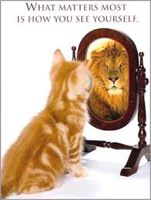
Viewing the world through the my lens
Self-esteem
Coping
Prioritisation
Context

Slide 24
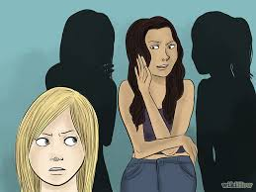
Resilience or toughness
Not the event but the reaction to the event
Critical consumerism, attention economy
Importance of savvy
Savvy is knowledge

Slide 25


The 4-7 Principle
The value of enough

Slide 26
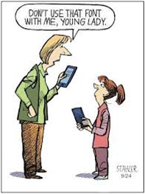
Competing with technology
In a world so short of time, time has never become more important
The need to entice children into ‘real’ relationships by role modelling these experiences
Filling in the gaps
The counter-conversations

Slide 27
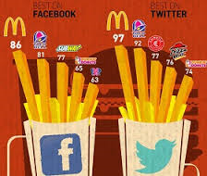
A need for conversation
We need to return to having a conversation
We need to teach children how to challenge the tech discourse
This can happen through role modelling and discussion
We need to disconnect and connect

Slide 28
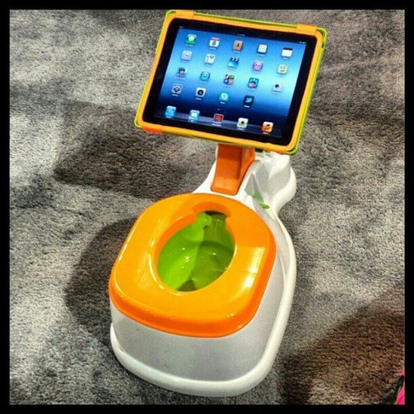
We need to up our game THO ;-)

